Slide 1
SE 361 Sprint #0 Review
Code Monkeys In Tech Support

Slide 2
Project Selection and Team Roles
IT Help Desk
Declan St John - Scrum Master
Beck Chandler - Back End
Charlie Zehner - GUI Front End
Jonathan Wang - GUI Front End
Josue Martinez - Back End

Slide 3
Scrum User Stories
As a User:
As an IT Support Member:
I can log in with a user ID and password.
I can access tutorials to solve common issues.
I can raise a ticket.
I am given space to describe my issue.
I can access a list of common causes to my issue.
I can check the status of my ticket.
I am notified when my ticket is updated or solved.
I can reopen my ticket if my issue is not resolved.
I can access a list of solved tickets.
I can see raised tickets, and update or solve them.
I am notified by email when I update or solve a ticket.
I can share a ticket with other IT Support members.
I can see reopened tickets marked with a higher priority.
Some tickets are directed to me for approval depending on the request type.
As a Reporting Manager:

Slide 4
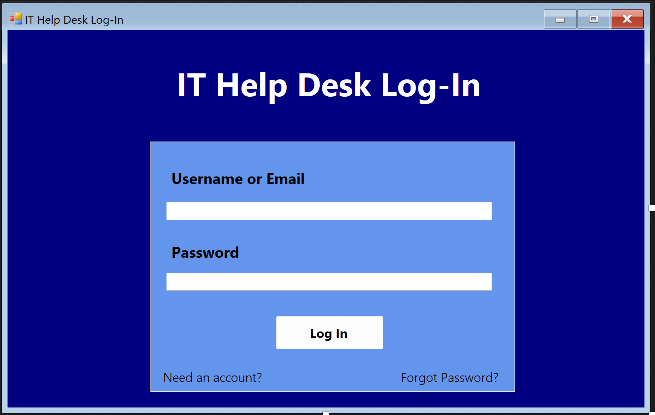
Prototype GUI Front End Design

Slide 5
Current Issues and Future Goals
Current Issues List
Non Functional Prototype
Github Configuration
Future Goals
Start work IT Help Desk classes
Function front end
Finalize design
Add more To-Do’s

